Slide 1
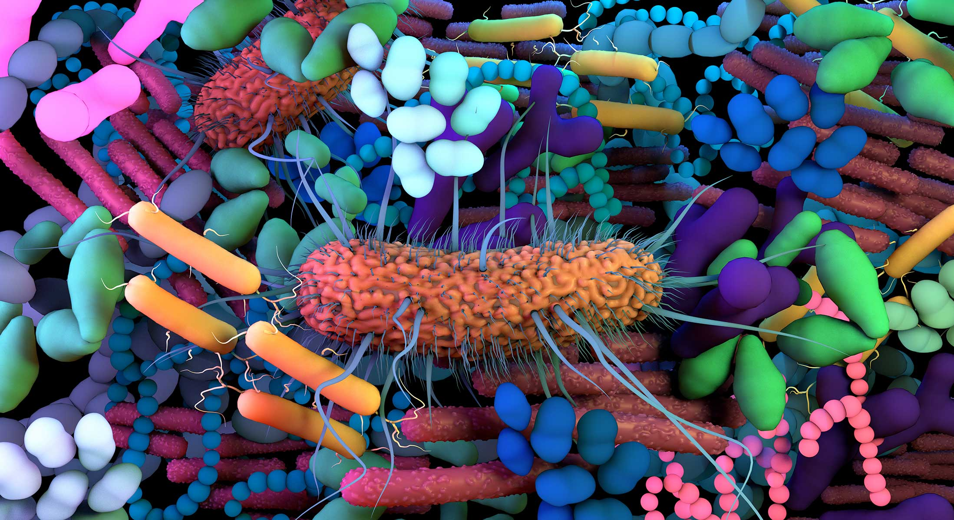
Bringing Order to Chaos:
Metagenomics Starting from Raw Reads
Computational Metagenomics - BioSB research school (26-10-2026)
Gijs Selten

Slide 2
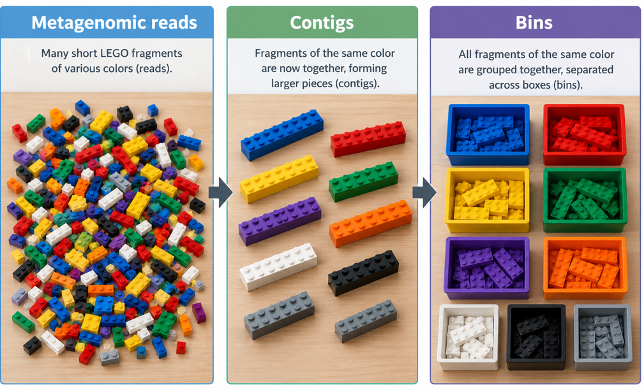
Bringing order to chaos

Slide 3
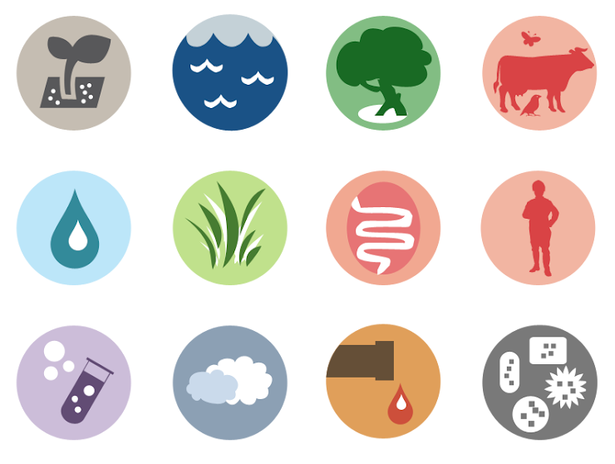
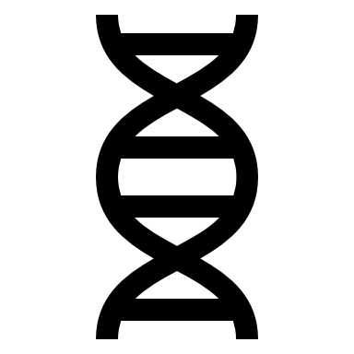
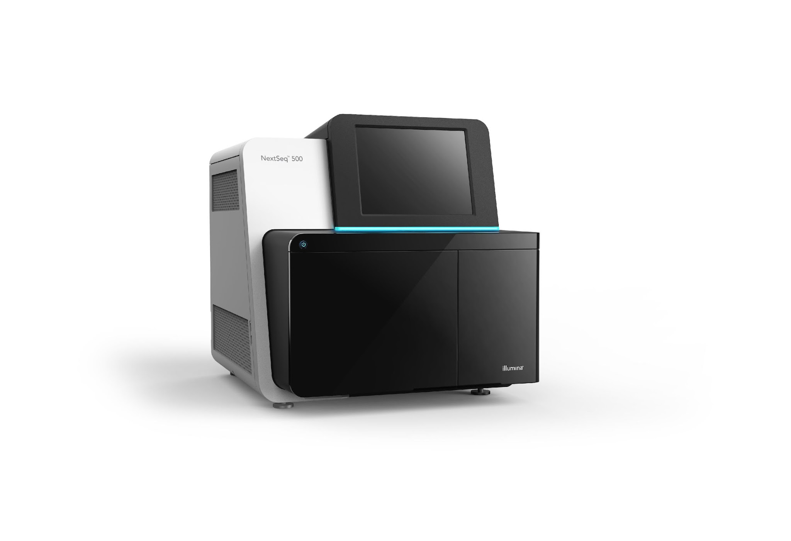
Metagenomics: Overview
Reads
DNA extraction
Sequencing
Experimental part

Slide 4
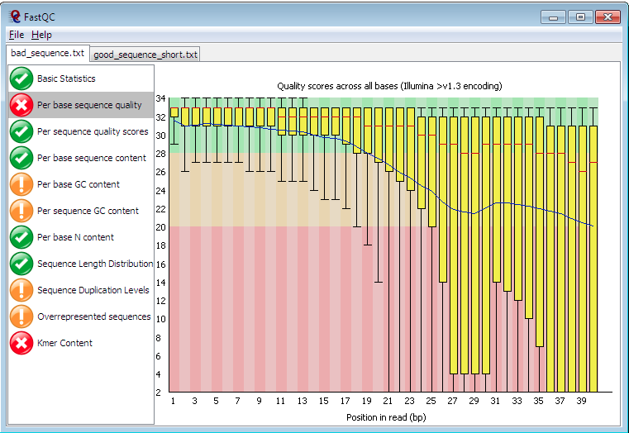
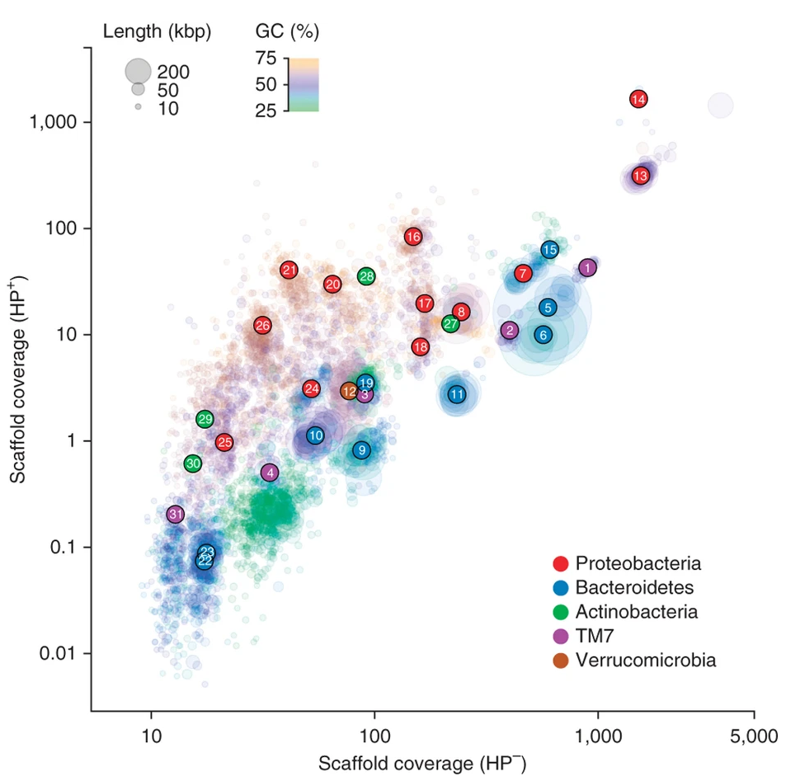
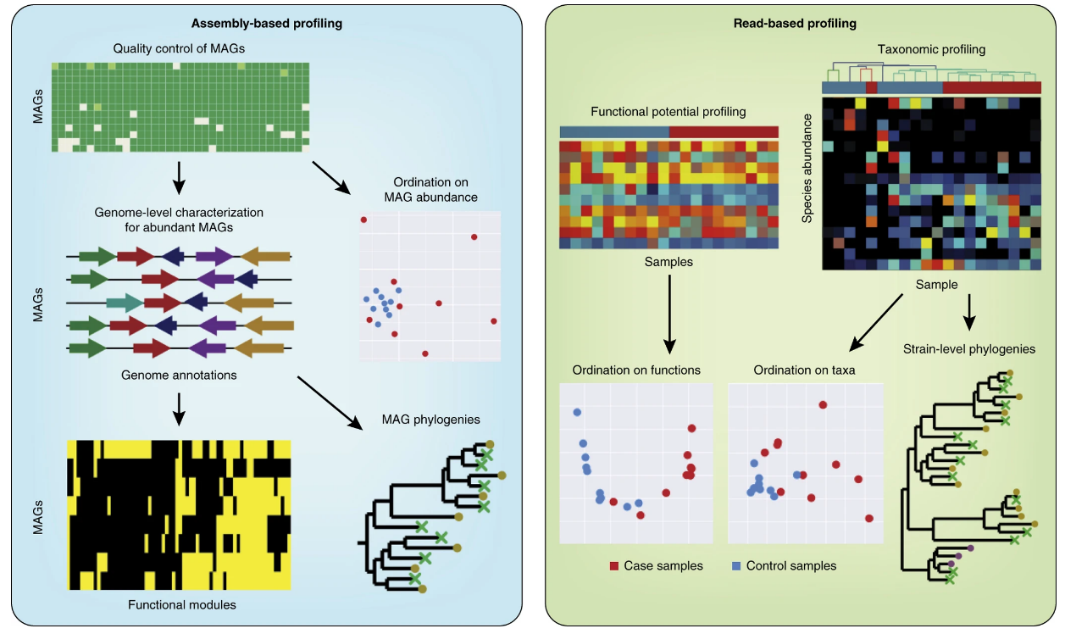
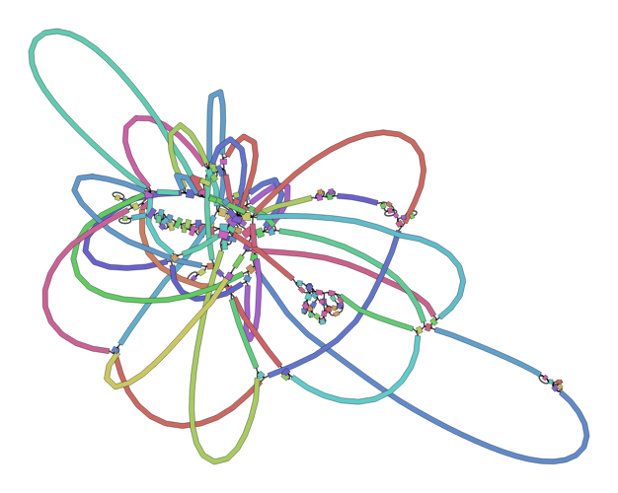


Metagenomics: Overview (today’s focus)
Reads
DNA extraction
Sequencing
Experimental part
Computational part
Day 2
4) Binning
3) Assembly
2) Read-based
Data preprocessing

Slide 5


Step 1: Data preprocessing
Reads
DNA extraction
Sequencing
Experimental part
Exploration
e.g., FASTQC
Computational part
Day 2
Data preprocessing
Processing

Slide 6
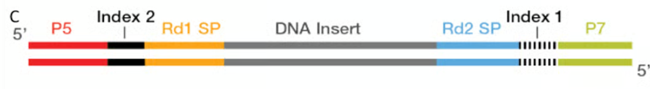
Data preprocessing - Adapters
Adapters are nucleotide sequences placed at either one or both ends of the DNA fragments that are being sequenced
They are composed of 3 sections:
▪ Sequencing primer binding site (illumina)
▪ Multiplexing index (P5-P7)
▪ Sequencer binding site (illumina)
They are necessary for sequencing but should be removed early on in data pre-processing steps
Double
Single
Index sample A
Index sample B
DNA sequence
Notes:
A primer binding site is necessary to amplify, and primers then attach an index and the sequencer binding site nucleotides

Slide 7
Data preprocessing - Demultiplexing
Demultiplexing tools: Sabre, iDemux, Cutadapt etc..
Generally performed by sequencing companies before sending
the data. Good to know what it is to be able to spot it in QC.
Index sample A
Index sample B
DNA sequence
Notes:
If you are doing it yourself, be sure to do an orientation check

Slide 8
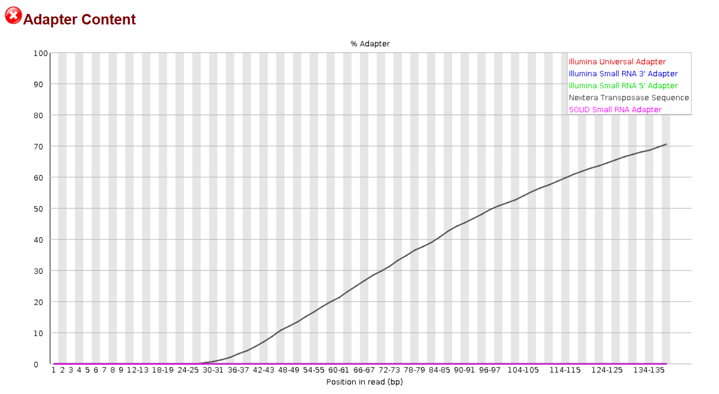
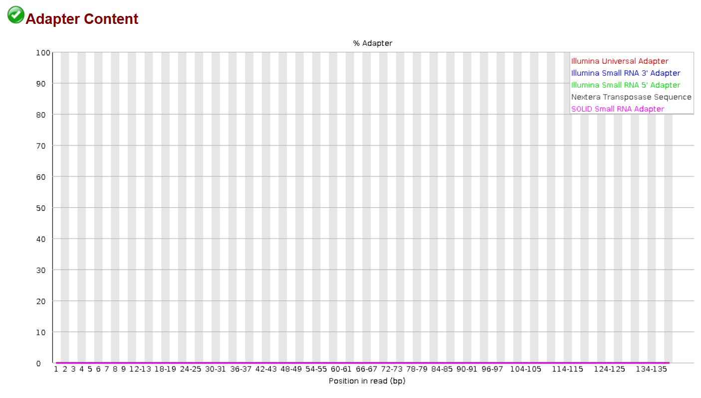
Data preprocessing - Adapter trimming
Adapters can be recognized in the QC data and removed (de novo or reference).
Recommended tools:
Trimmomatic, Cutadapt, bbduk, fastp
After adapter removal, rerun QC
on the fastq files to check
Notes:
Poly G can indicate the end of a read.

Slide 9
Data preprocessing - Quality filter
Phred quality score – Logarithmic score representing the quality of a nucleotide
Phred Quality Score | Probability of incorrect base call | Base call accuracy
10 | 1 in 10 | 90%
20 | 1 in 100 | 99%
30 | 1 in 1000 | 99.9%
Notes:
At the end of the read the quality score drops due to phasing. Every cycle a nucleotide is added to a cluster of DNA fragments. When a nucleotides is not incorporated in one DNA fragment, it is an error, and it is one nucleotide behind the rest, increasing the chances that more errors can creep in (polluting the light signal). The reverse reads go in the reverse direction, and that is more prone to errors than forward reads.

Slide 10
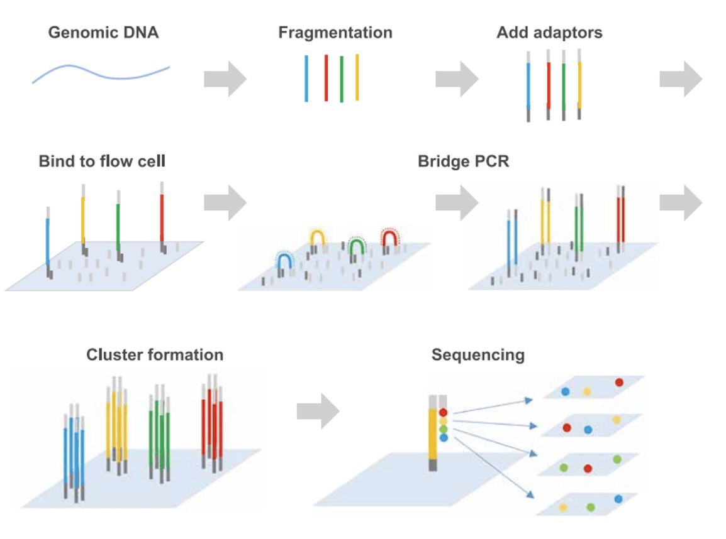
Data preprocessing – other quality measures
Good to check all ‘attention’ points, but remember what your data looks like (!)
GC & Kmer content & sequence duplication levels
  Dependent on diversity (do you have low diversity samples?)
  Dependent on evenness (do you expect dominant taxa in your sample)
  Dependent on repetitive sequences within genomes.
Keep an eye out for poly G tails
Notes:
FastQC was designed around single-genome or single-transcriptome libraries, where the expectations are simple: a roughly unimodal GC distribution, low duplication, no enriched sequences.

Slide 11





Data preprocessing - Host (& other) removal
e.g. Bowtie2, BWA, bbduk,
KneadData, HoCoRT
Rhizosphere Microbiome
Plant reads

Slide 12


Metagenomics: Read-based
Reads
DNA extraction
Sequencing
100-150 bp
The read based:
Mapping into databases
Cleaned reads
Read-based approach

Slide 13
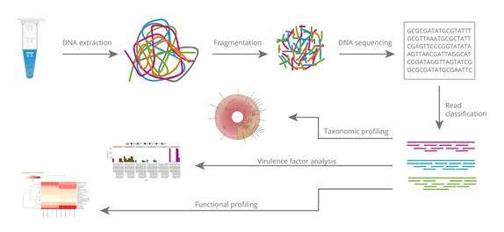
Read-based approaches
Align short-reads to different databases containing reference sequences
Taxonomic
profiling
Virulence factors
Antibiotic resistance genes
Functional profiling
Read-based ≃ Reference-based
Notes:
read-based approaches involve analyzing the sequencing reads directly, rather than assembling them into longer contiguous sequences (contigs).
Read-based ≃ Reference-based
Align short-reads to different databases containing reference sequences

Slide 14
Read-based approaches
Align short-reads to different databases containing reference sequences
E.g. Metaphlan, Kraken, kaiju, RAT
Taxonomic
profiling
Virulence factors
Antibiotic resistance genes
Functional profiling
Read-based ≃ Reference-based
Notes:
Classifying reads based on their similarity to known sequences in reference databases (e.g., using tools MetaPhlAn or Kraken).
Assigning reads to taxonomic ranks (e.g., species, genus, family) based on these matches.
MetaPhlAn uses clade-specific marker genes while Kraken uses whole-genome databases and k-mer-based alignment

Slide 15
Read-based approaches
Align short-reads to different databases containing reference sequences
Taxonomic
profiling
E.g. HUMAnN,
MetaPathways
Virulence factors
Antibiotic resistance genes
Functional profiling
Read-based ≃ Reference-based
Notes:
HUMAnN maps the identified gene families to metabolic pathways using a reference pathway database (e.g., MetaCyc).
HUMAnN uses a two-step strategy to map reads to known sequences, making use of both protein databases and nucleotide databases:
Reads are first aligned to a reference protein database (e.g., UniRef90 or UniRef50, which contain protein families clustered at different levels of sequence identity).
This allows HUMAnN to identify reads that match known protein-coding genes and provides functional annotation.
Reads that do not map to protein families are then aligned to a custom nucleotide database (e.g., ChocoPhlAn, which includes microbial genomes).
This helps detect additional gene families that may not be present in the protein database.

Slide 16
Read-based approaches
Align short-reads to different databases containing reference sequences
E.g. ShortBRED, ResFinder, DeepARG
Taxonomic
profiling
Virulence factors
Antibiotic resistance genes
Functional profiling
Read-based ≃ Reference-based
Notes:
ShortBRED is designed to detect and quantify specific protein families, such as Virulence factors and Antibiotic resistance genes in a metagenomic dataset by using marker sequences derived from known protein families.

Slide 17

Metagenomics workflow: Assembly-based
Reads
DNA extraction
Sequencing
100-150 bp
Assembly-based approach
Assembly
Cleaned reads
Contigs
1000+ bp

Slide 18



The Assembly Problem:
Library of books
Shred all books
Reconstruct each book
Sequencing
Assembly
Notes:
Imagine you have a library filled with books. Each book contains a complete, coherent story or piece of information.
Now, imagine that you shred each book into small pieces and mix them together, so you no longer know which fragment belongs to which book.
Now attempt to reconstruct each book using the mixed collection of fragments. The goal is to piece together the fragments in the correct order to recreate each original story.
This represents the process of sequencing a genome, where DNA is fragmented into short reads.
This is similar to de novo genome assembly, where you try to piece together short reads into longer contiguous sequences (or contigs), ultimately reconstructing the original genome.

Slide 19

Repetitive content makes the reconstruction more difficult
Notes:
If some sections of the books contain repeated sentences, phrases or paragraphs, it becomes more challenging to determine where each fragment fits.
Similarly, in genome assembly, repetitive sequences create ambiguities in the assembly process where multiple reads can map to different occurrences of the repetitive sequence

Slide 20
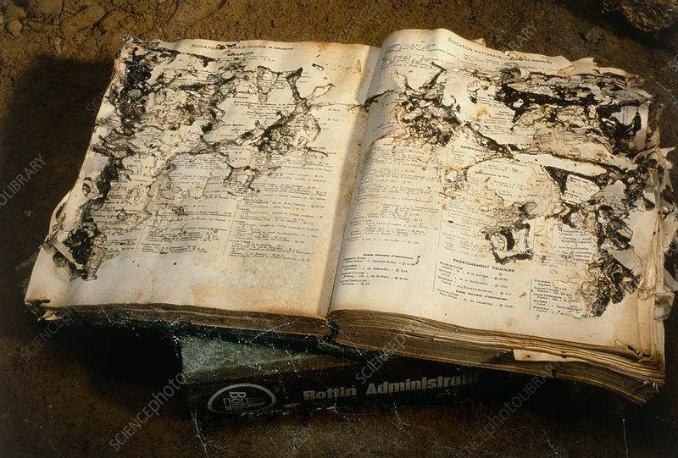
Misprints or damaged fragments make reconstruction more difficult
Notes:
Some fragments may also be damaged or contain misprints, making it difficult to know IF the original text was like this OR if an error occurred during the shredding process.
Similarly, in genome sequencing, sequencing errors introduce incorrect bases that can lead to mis-assemblies if not properly corrected.

Slide 21


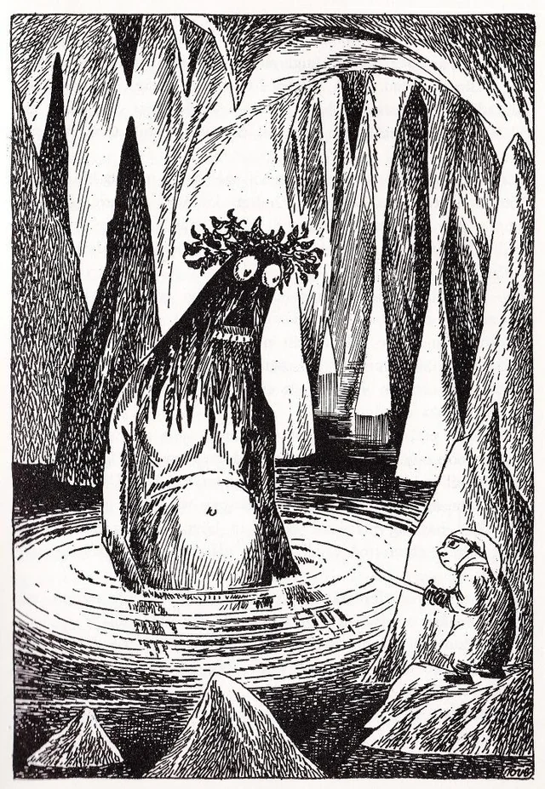
Rare books are difficult or impossible to reconstruct
Notes:
And finally, it may be impossible to reconstruct certain rare copies or books, because you don't have enough fragments from them.
In genome assembly, coverage refers to the average number of times each base in the genome is sequenced.
Low coverage may result in gaps where certain regions are not well represented, or rare genomes completely missing from the assembly.

Slide 22
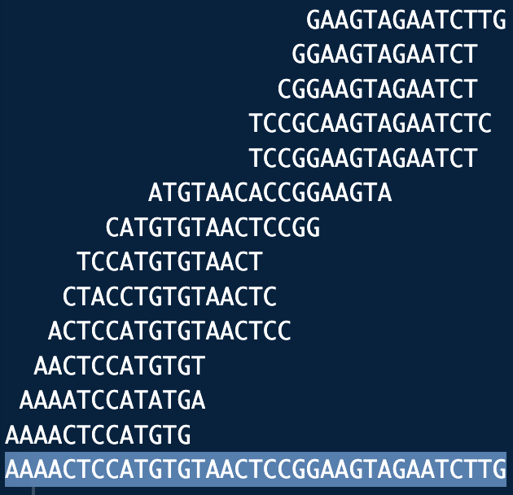
Back to DNA sequences…
From these
short reads…
Genome:
reconstruct this
Notes:
From these short reads reconstruct this.
Why is this example misleading?

Slide 23
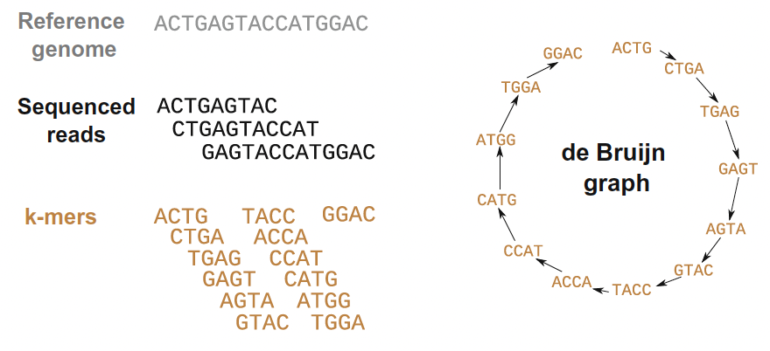
Modern short-read assemblers use the de Bruijn graph
k-mers are nodes and k-1 overlaps are edges
Notes:
Modern short-read assemblers don’t use overlap graphs but rather something called the de Bruijn graph.
Where each read is broken into k-mers
k-mers are added to the graph as nodes if they are unique
Edges are drawn between adjacent k-mers based on k-1 overlaps
Why this graph method works on short-reads is because it scales linearly instead of quadratically.
If a k-mer appears multiple times across different reads, it is stored in the graph as a single node.
You do not need to compare each instance of a k-mer with all others, as each k-mer is only added to the graph once.
When an identical k-mer is encountered again, the graph simply reinforces the existing node or updates the edge information (e.g. by increasing the edge weight), rather than creating new comparisons.
This means that the number of operations performed remains proportional to the number of k-mers in the input, not the number of unique comparisons.
This means that the de Bruij graph scales linearly instead of quadratically as the overlap graph does.

Slide 24
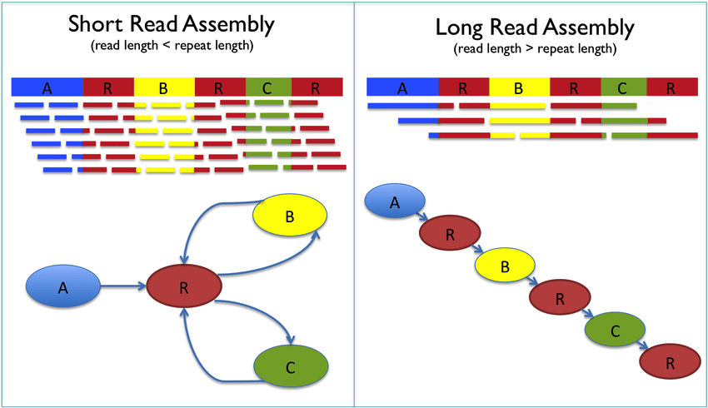
Linear vs cyclic De Bruijn graphs
Repetitive sequences cause assembly problems
Solutions?
Notes:
So as it turns out, the long read (OR combined with short-read sequencing - so hybrid sequencing) will introduce a paradigm shift in assembly, where it will actually be possible to go back to the overlap graph which was not feasible on short-reads

Slide 25
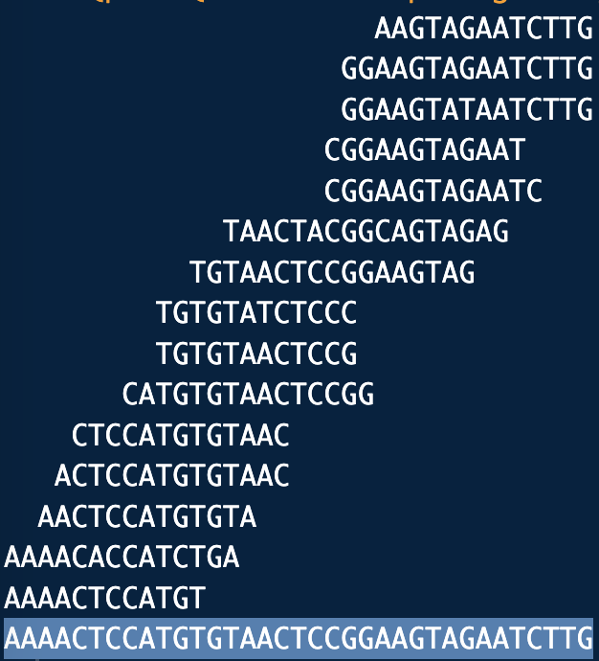
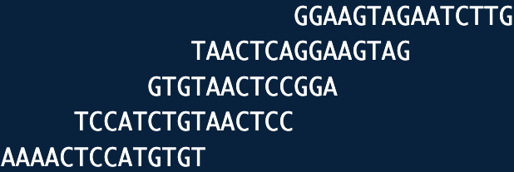
More coverage leads to more and longer overlaps
Average coverage: 207/35 ≈ 6-fold
Coverage=8
Genome:
Average coverage: 70/35 = 2-fold
Coverage=3
Notes:
We can look at the coverage for each base. The more reads we have covering a specific base tells us something about how certain we can be that this base in the sequence we are trying to assemble is indeed an “A”. This is called depth of coverage.
We can also compute the average depth of coverage which gives us the average number of times each base in the genome is sequenced, and is computed by taking the total number of bases sequenced divided by the total genome length.

Slide 26
Notes:
This figure shows the problem with short-reads where the read length is often shorter than the repeat lengths, which we have learned makes the assembly process difficult by introducing forking and/or circular paths in the overlap graph.
The best solution to overcome the difficulty of repeats, is to use long reads where the read length is longer than the typical length of repeats.

Slide 27
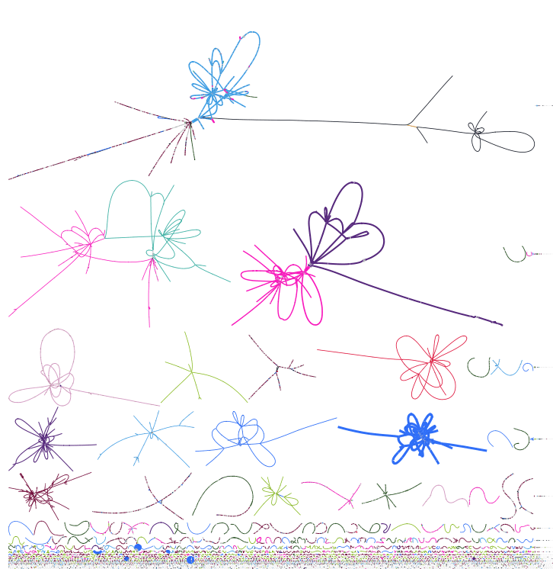
Yet in complex metagenomes, many contig breaks are also due to lack of coverage
https://tylerbarnum.com/2018/02/26/how-to-use-assembly-graphs-with-metagenomic-datasets/
Notes:
So in practice this means that in metagenomes the most abundant microbial taxa may have a near-complete genome, though with short reads, these do not form one long genome sequence stretch, but a bins of contigs. There are also many stretches of DNA/contigs that are small, which often derive from rare taxa with low coverage.

Slide 28
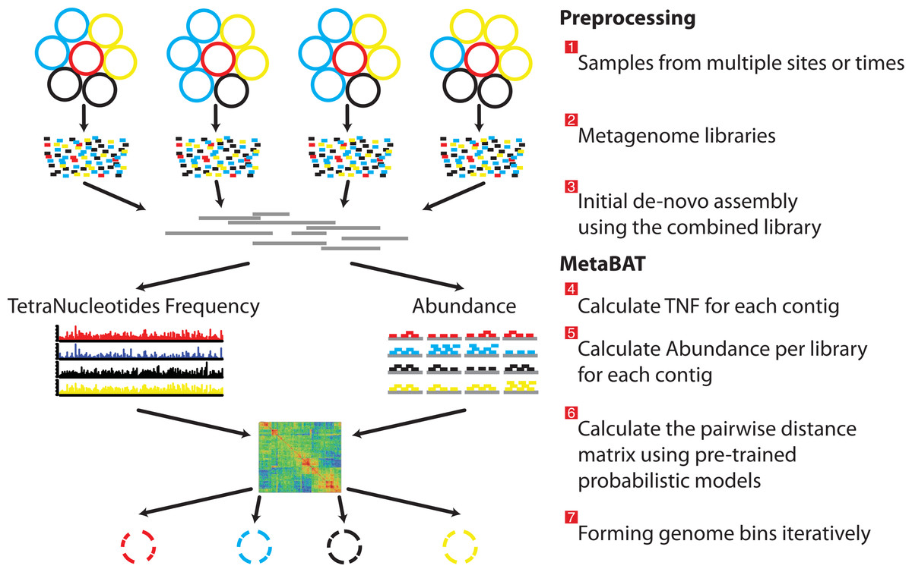
Binning procedure
Notes:
What tools can be used for binning. Here you can see the same figure from earlier in which tools can use the abundance profiles of contigs – meaning the number of metagenomic reads that map contigs, and the tetranucleotide frequency of contigs to group/bin contigs together based on these similarities.
There are MANY binning tools, estimated more than 30 tools and counting. So sometimes tools require aggregating multiple binning tool results to get the best result. What each of these binning tools does differently should be checked in the tools’ vignette.

Slide 29
Automatic tools for binning
Tools:
MetaBAT2
Maxbin2
CONCOCT
Aggregate multiple binning results:
e.i. DASTool
New kids in the playground:
VAMB
SemiBin
MetaDecoder
Overview of the MetaBAT pipeline.
Notes:
What tools can be used for binning. Here you can see the same figure from earlier in which tools can use the abundance profiles of contigs – meaning the number of metagenomic reads that map contigs, and the tetranucleotide frequency of contigs to group/bin contigs together based on these similarities.
There are MANY binning tools, estimated more than 30 tools and counting. So sometimes tools require aggregating multiple binning tool results to get the best result. What each of these binning tools does differently should be checked in the tools’ vignette.

Slide 30
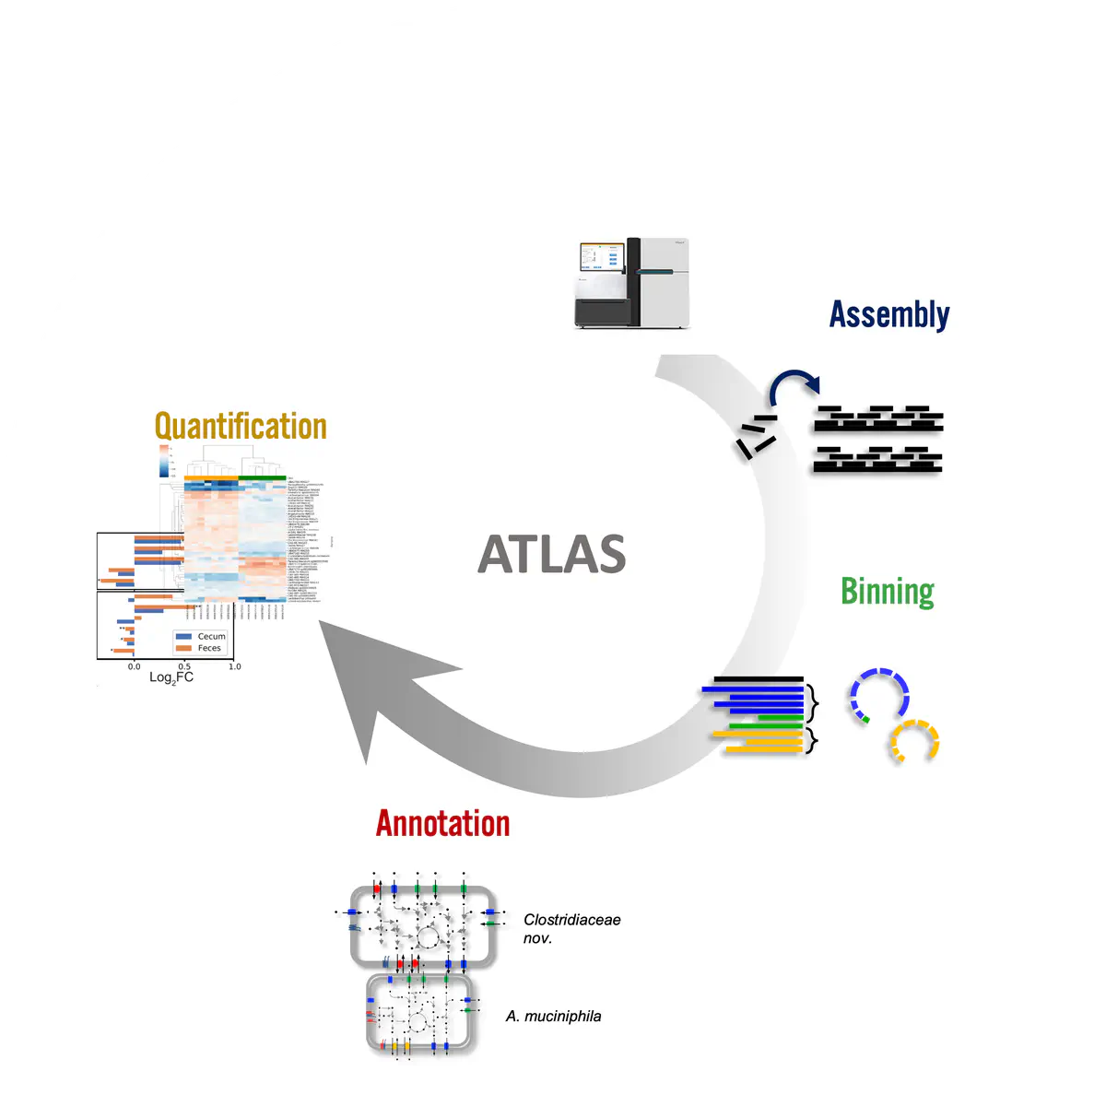
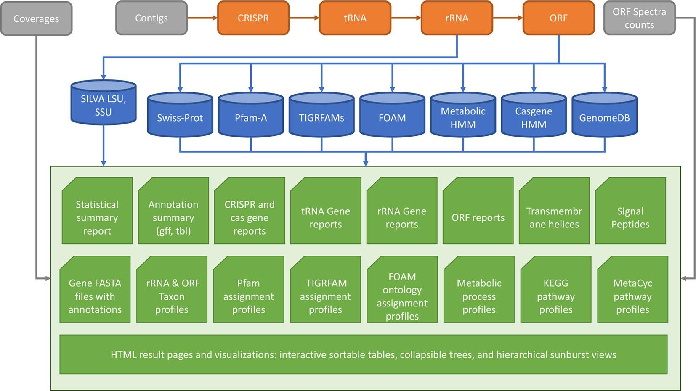
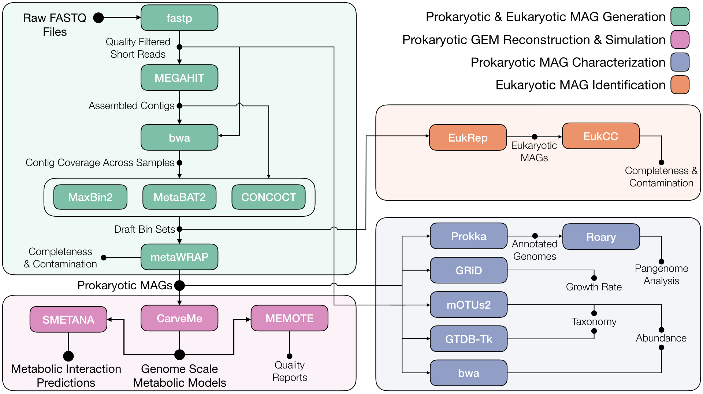
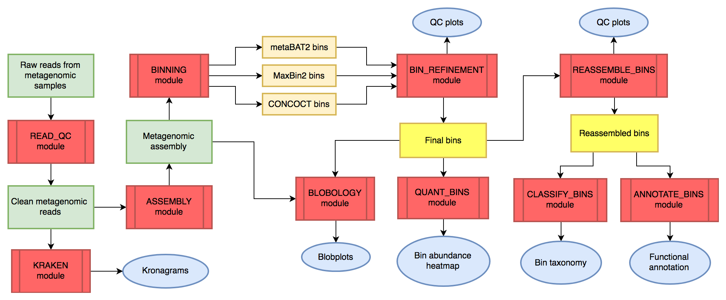
(Semi)Automatic pipelines
Atlas
MetaErg
metaGEM
MetaWRAP
Notes:
There are even automatic pipelines that use the metagenomic reads as input and use all the steps – checking read quality, assembling reads into contigs, binning contigs, and using genome assembly quality checks, all at one go.

Slide 31




In practice
Manually
Mixed
Automated
High sensitivity
High specialization
High time consumption
Bad sensitivity
Easy to use
Fast results
Aggregation:
DAS Tools
MetaWRAP
Binners:
MetaBAT2
CONCOCT
MaxBin2
…
Good sensitivity
Medium specialization
Medium time consumption
Refinement:
Anvi’o
Mdmcleaner
MAGpurify
Notes:
You can imagine that results from these automated pipelines are easy and fast, especially when doing all these steps yourself. Trying multiple binning algorithms yourself to find the best one leads to high sensitivity and will learn you a lot, but it also takes a lot of time. Instead, by using tools that aggregate individual binning tools, like DAS Tools, still a good sensitivity can be acquired. Especially when combining this with refining tools to create clean genome assemblies.

Slide 32
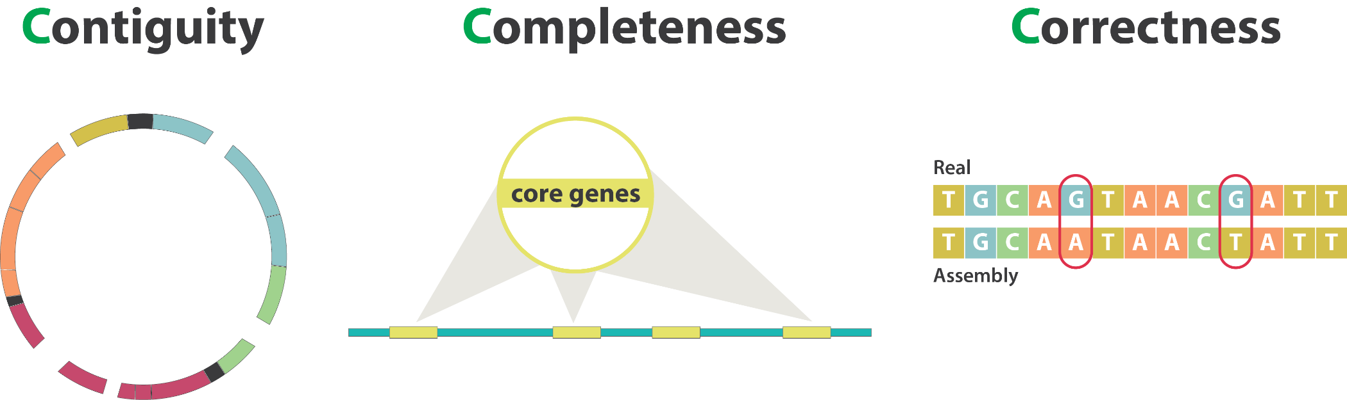
Metagenome data input quality determines data output quality
Notes:
Of course, if you have to try multiple binning tools to find the best result, e.g. if you acquire low contiguity and completeness. It might be because of the data quality so be sure to check your data quality, and if you can’t acquire a better result, you’ll have to do with what is being given to you.
So how do you know whether your bins are of good quality? We often check multiple ‘C’s, contiguity-number of breaks in the assembly, completeness- number of present marker sequences, and correctness. Though I also like to add another C, namely ‘Contamination’.

Slide 33
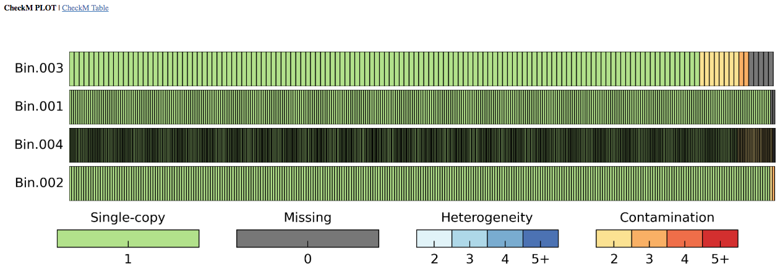
CheckM2 uses single-copy orthologs to assess completeness
~100% found: complete genome
<<100% found: incomplete genome
>>100% found: contamination
Notes:
There are more tools, but the most used one is checkm, which first infers taxonomy of your assembly and then checks whether all the single-copy marker sequences of that taxon in the database are present in your assembly. If some single copy marker sequences occur multiple times, there can be either heterogeneity or contamination. The difference between these two depends on the sequence similarity, in which two highly similar copies of a marker gene are heterogenous genes (meaning contamination of phylogenetically close strains) and if there is more dissimilarity, we will be talking about contamination.

Slide 34
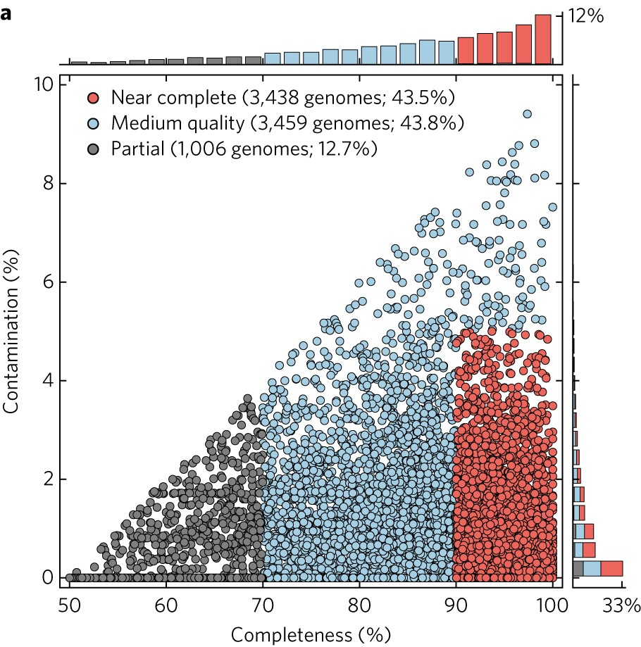
Metagenome bins are of varying quality
https://doi.org/10.1038/s41564-017-0012-7
Notes:
You can see in MAGs, that there is varying quality, with rare taxa often having low completeness and abundant taxa high completeness due to high coverage. With high contamination, the quality also goes down.

Slide 35
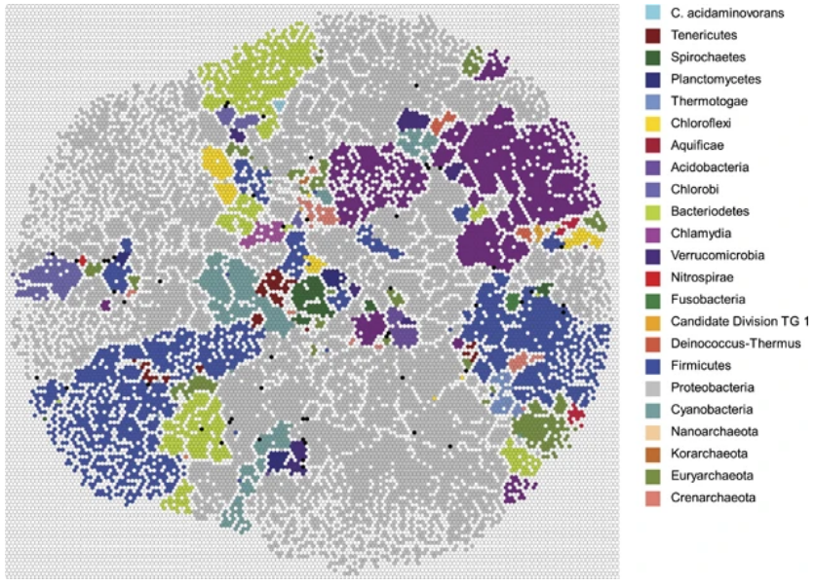
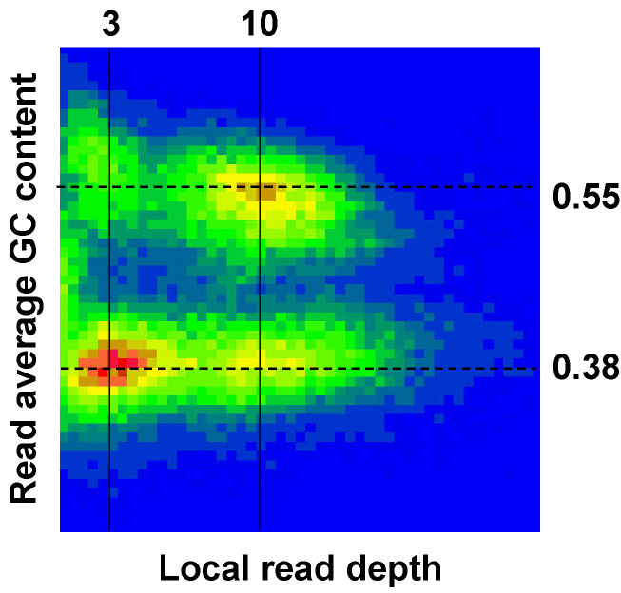
Ways to identify contamination
Is my genome overcomplete? (e.g., >> 100% completeness)
Anomalies found in GC % distribution? (e.g., a bimodal distribution)
Anomalies found in tetranucleotide profile?
Weber et al. 2011
Tyson et al. 2004
Notes:
Fow low continuity and completeness, you could try different binning tools or combining binning tools to get better results. When there is contamination, however, different tools should be used.
You’ll discover contamination due to overcompletion of the genome, e.g. from checkm2.
Also if you calculate the GC content of different contigs or you focus on reads and find that they are mainly of two different GC contents, these may originate from different bacterial genomes.
A similar thing can be found when cutting up the bacterial genome into oligo or tetranucleotide fragments. The abundance profile of these fragments may determine from what species the contig is from. Different profiles (bimodal distribution) may indicate contigs from different microbial species.

Slide 36
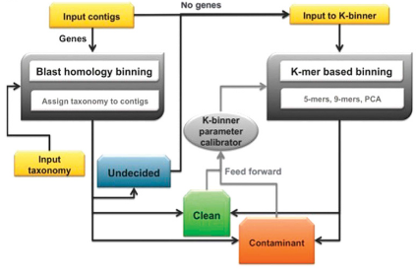
Ways to identify contamination
Is my genome overcomplete? (e.g., >> 100% completeness)
Anomalies found in GC % distribution? (e.g., a bimodal distribution)
Anomalies found in tetranucleotide profile?
Is taxonomic assignment consistent at contig-level? (e.g., Homo sapiens contigs in a bacterial genome)
What to do if contamination found?
Decontaminate, manually or automatically (e.g., MDMcleaner, ProDeGe or MAGpurify)
Notes:
Also if the taxonomic assignment of a contig is completely different from the rest of the contigs, like a human contig amidst bacterial contigs, it is also a contamination.
Fortunately there are tools that use homology-based algorithms and k-mer based algorithms to decontaminate genomes.

Slide 37

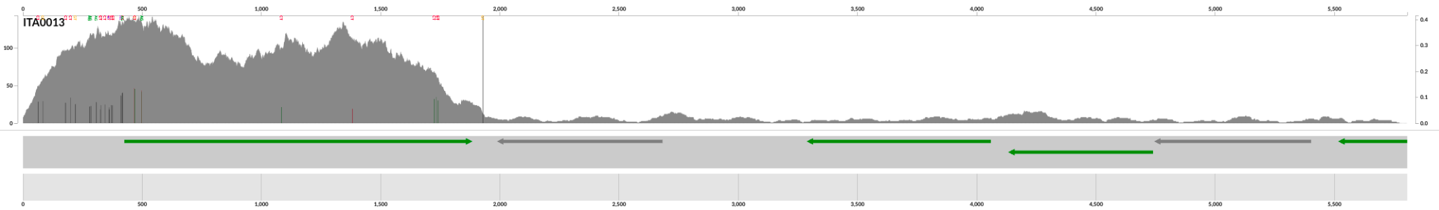
Assessing other assembly quality metrics
Number of contigs
Average/median contig length
Min/Max contig length
N50: The length of the contigs which covers 50% of genome
Read recruitment: Percentage of all reads mapped back to the assembly
Evenness in depth along contig
https://merenlab.org
Notes:
Evenness in depth along contig: figure shows one contig, which has very uneven coverage. This could indicate a chimeric contig consisting of reads from two organisms, for example.

Slide 38
Metagenomics workflow: Coverage
Reads
DNA extraction
Sequencing
100-150 bp
e.g. Bowtie2
BWA
SAMtools
…
Assembly
Mapping
Scaffolds
Taxonomy
Function
1000+ bp
Genome

Slide 39


Coverage
$$Depth=\frac{read length x no of reads}{Size of contig/bin}$$
Depth
$$Breadth=\frac{Number of bases with minimum depth}{Size of contig/bin} x 100\%$$
Breadth
Depth of coverage (mapping depth)
Average number of times each nucleotide is covered in the assembly
  Estimate to the abundance of a sequence in the sample
Breadth of coverage (covered length)
Percentage of bases of a targeted genome that are covered with a certain depth
  Metagenomic assembly quality – percentage of data included in the assembly
  Identify chimeric regions
Notes:
Different colors

Slide 40
Metagenomics workflow: Taxonomy
Reads
DNA extraction
Sequencing
100-150 bp
Assembly
Mapping
Stay tuned: Tuesday October 27th
Scaffolds
Taxonomy
Function
Genome
1000+ bp

Slide 41

MGXlab: taxonomy assignment on all three levels
Fraction of data represented
Taxonomic annotation of MAGs with BAT
Taxonomic annotation of contigs with CAT
Taxonomic annotation of reads with DIAMOND
RAT
Integrated taxonomic profiling
Reliability of taxonomic annotation
20 metagenomic classifiers compared:
Simon et.al, 2019 (https://doi.org/10.1016/j.cell.2019.07.010)

Slide 42
Metagenomics workflow: Function
Reads
DNA extraction
Sequencing
100-150 bp
Assembly
Mapping
Scaffolds
Taxonomy
Stay tuned: Tuesday October 27th
Function
1000+ bp
Genome

Slide 43
Metagenomics workflow: Assembled-based analysis
Reads
DNA extraction
Sequencing
100-150 bp
Assembly
Mapping
Scaffolds
Taxonomy
Assembled-based
Function
1000+ bp
Genome

Slide 44
Read vs assembly-based approaches
Read-based vs Assembly-based – Advantages
  Low costs with more shallow sequencing
  Faster results
  Taxonomic profiling on larger fraction of the data
Assembly-based vs Read-based – Advantages
  No need for reference databases
  Functional profiling possible
  More reliable taxonomic profiling
  Information on intragenomic cooccurrence of functions
Notes:
When deciding to use a read-based or assembly-based approach, it should be clear what the advantages and/or disadvantages of either method.
In read-based approaches you will have fast results and you don’t require a high sequencing depth. On the other hand, however,
- You will only be looking at the taxonomies and functions that your reads are mapping to, and so a lower sequencing depth will still not paint a complete picture of the metagenome.
You do not know which functions cooccur in the same microbial genome
You are largely dependent on reference databases.
Assembly-based approaches can help with these shortcomings.

Slide 45
MAG/assembly-based vs. read-based v2
Criteria: | MAG/Assembly-based analysis | Read-based analysis ('mapping')
Comprehensiveness | Low/Medium | Low/Medium/High
Community complexity | Low/Medium | High
Novelty | High | None
Computational burden | High | Low
Genome-resolved metabolism | High | Low
Expert manual supervision | High | Low/Medium
Integration with microbial genomics | High | None
Quince et.al., 2017

Slide 46
MAG/assembly-based vs. read-based v2
Criteria: | MAG/Assembly-based analysis | Read-based analysis ('mapping')
Comprehensiveness | Low/Medium | Low/Medium/High
Community complexity | Low/Medium | High
Novelty | High | None
Computational burden | High | Low
Genome-resolved metabolism | High | Low
Expert manual supervision | High | Low/Medium
Integration with microbial genomics | High | None
Choose according to your question!
Quince et.al., 2017

Slide 47
Metagenomics is a great tool but...
Abundance is compositional
  Not easy to be quantitative with microbial communities
    ?Integrate metagenomics/barcoding with qPCR, DNA spiking, flow-cytometry and microscopy?
We are measuring the DNA content, therefore viable & non viable cells
  RNA, CFUs (if culturable)
We investigate potential functionality, not activity
  Multi-omics: Adding layers of information (RNA, protein, metabolites)
No clue on spatial organization
  Microscopy
Notes:
Carbon content add. Add to abundance solution to abundacne

Slide 48

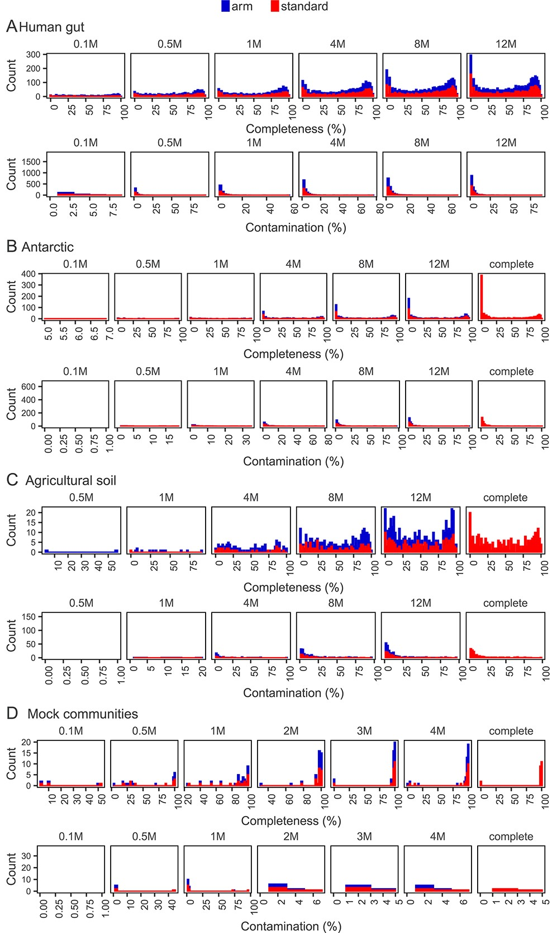
Challenges of getting genomes from metagenomes across environments:
The more data, the better?
Julien Tremblay, Lars Schreiber, Charles W Greer, High-resolution shotgun metagenomics: the more data, the better?, Briefings in Bioinformatics, Volume 23, Issue 6, November 2022, bbac443, https://doi.org/10.1093/bib/bbac443
Notes:
High quality recovery of MAGs against Avg. read depth, total read depth and diversity (richness, ?
In parallel, the all reads mapped (arm) workflow was executed. This workflow consists of mapping the complete full size fastq libraries (i.e. in the context of this article, a sequencing library is considered analogous to a sample) to estimate read abundance, instead of using only a fraction of the reads like it is the case in the standard workflow (Figure 1).

Slide 49
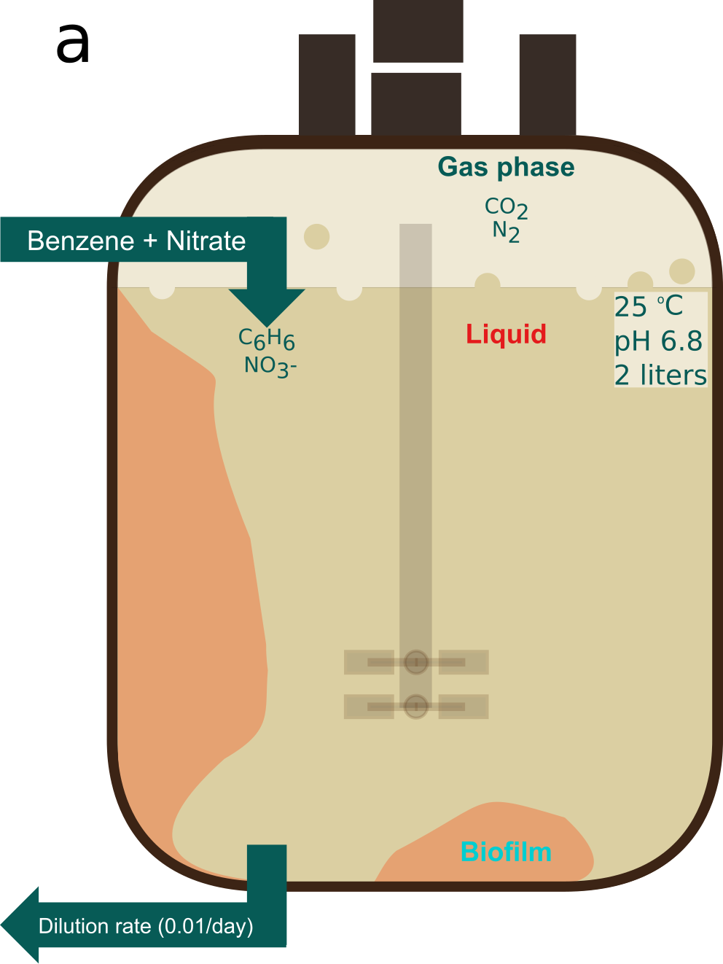




Challenges of getting genomes from metagenomes across environments
# high quality MAGs
Total sequence depth

Slide 50
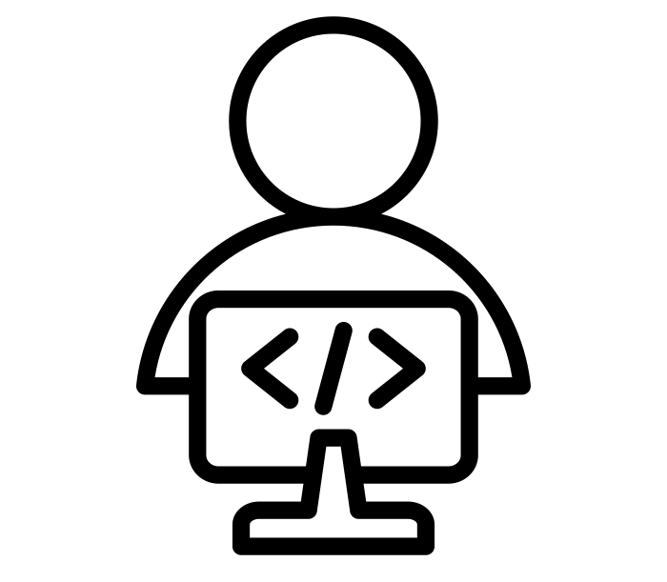
Practicals
Connect to JupyterHub: https://bioinformatics.nl/biosb_metagenomics
>https://wur-bioinformatics.github.io/biosb-metagenomics/

